Slide 1
Heuristic classifier, strategy C
October 2024
Andrea Corrado

Slide 2
Outline
Why building a heuristic classifier
Knowledge on roving signals: recap
Heuristic classifier: pseudo code
Performance
Conclusions

Slide 3
Outline
Why building a heuristic classifier
Knowledge on roving signals: recap
Heuristic classifier: pseudo code
Performance
Conclusions

Slide 4
Why building a heuristic classifier
Problem
Which model could act as baseline for building and comparing any other one?
In literature there’s no evidence of AVNRT roving signals classification
Proposed solution
So, a first classifier, which could cover this role, could be a heuristic one based on prior information on these signals
Aim
Building a logical set of rules to classify roving signals exploiting the prior on them

Slide 5
Outline
Why building a heuristic classifier
Knowledge on roving signals: recap
Heuristic classifier: pseudo code
Performance
Conclusions

Slide 6
Knowledge on roving signals: recap
Map A: indifferent
Atrial wave amplitude >0.5 mv
Simple and biphasic shape of atrial wave
No slow-path signal
Minor presence of the Ventricular component
Map B: effective
Complex atrial component within 0.1 and 0.3 mV
Higher ventricular component
Map C: dangerous
3 components: atrial activity, ventricular activity and His Bundle passage
Not fixed proportions between atrial and ventricular components
Clear and biphasic atrial component
These priors have been defined on the bases of experience: what if a preprocessing step proceeded the classification? See Appendix 3.

Slide 7
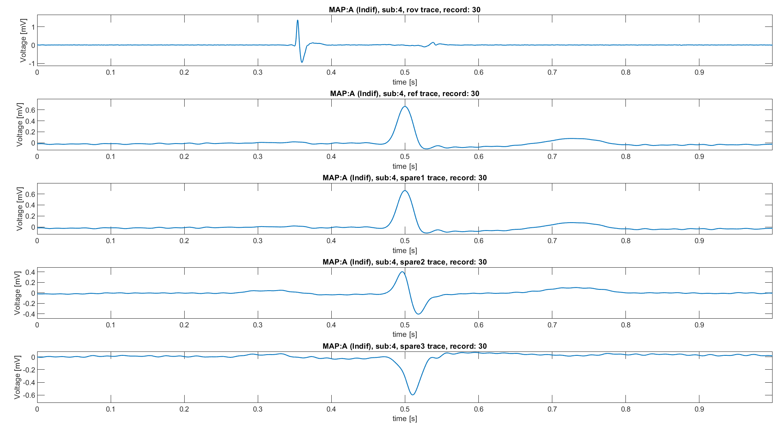
Knowledge on roving signals: recap
Map A
Atrial wave amplitude >0.5 mv
Simple and biphasic shape of atrial wave
No slow-path signal
Minor presence of the Ventricular component
ECG 1
ECG 1
Used for building the classifier
ECG 2
ECG 3

Slide 8
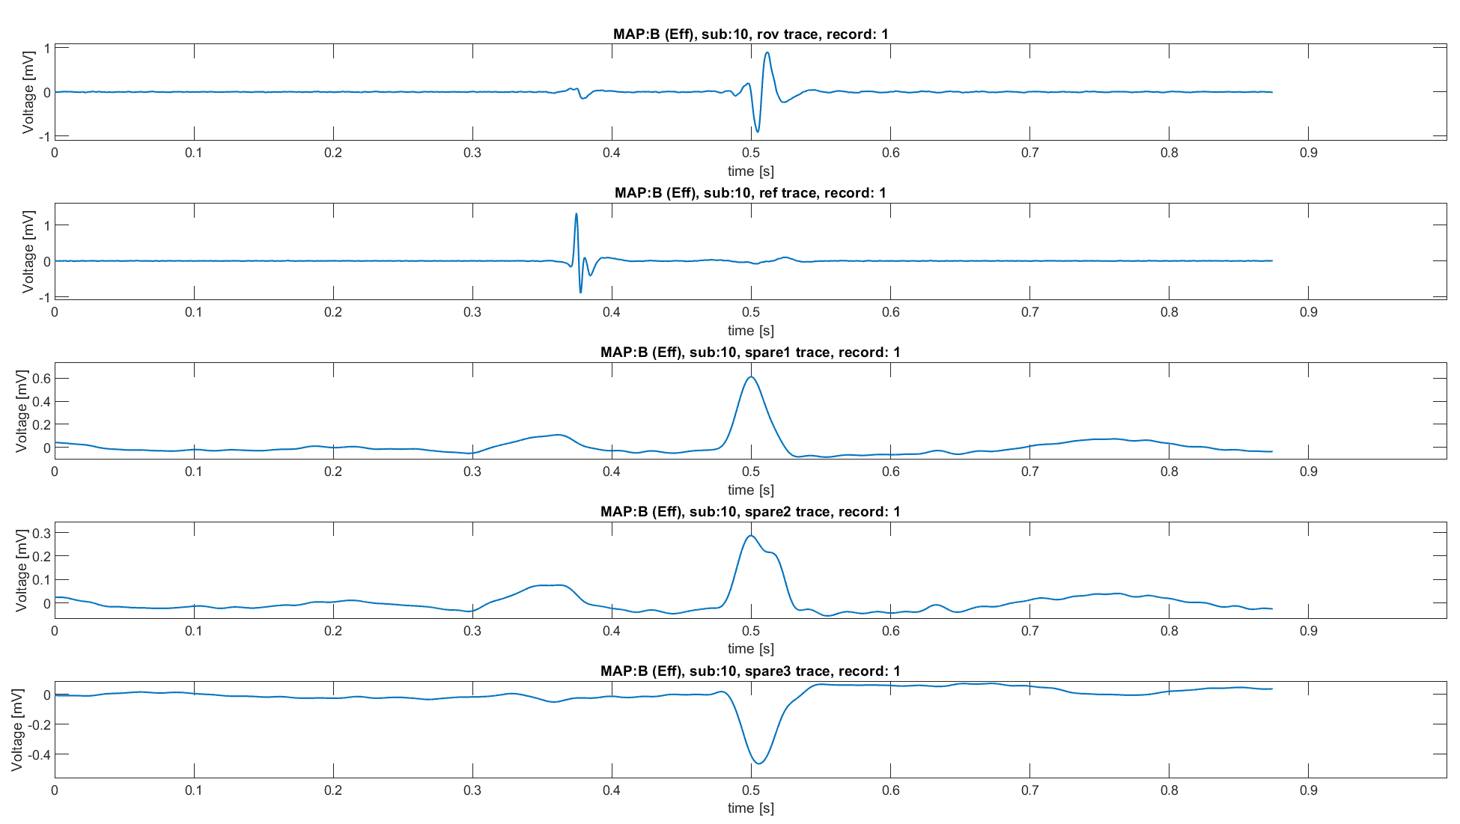
Knowledge on roving signals: recap
Map B
Complex atrial component within 0.1 and 0.3 mV
Higher ventricular component
CS 3-4
Used for building the classifier
ECG 2
ECG aVF
ECG V1

Slide 9
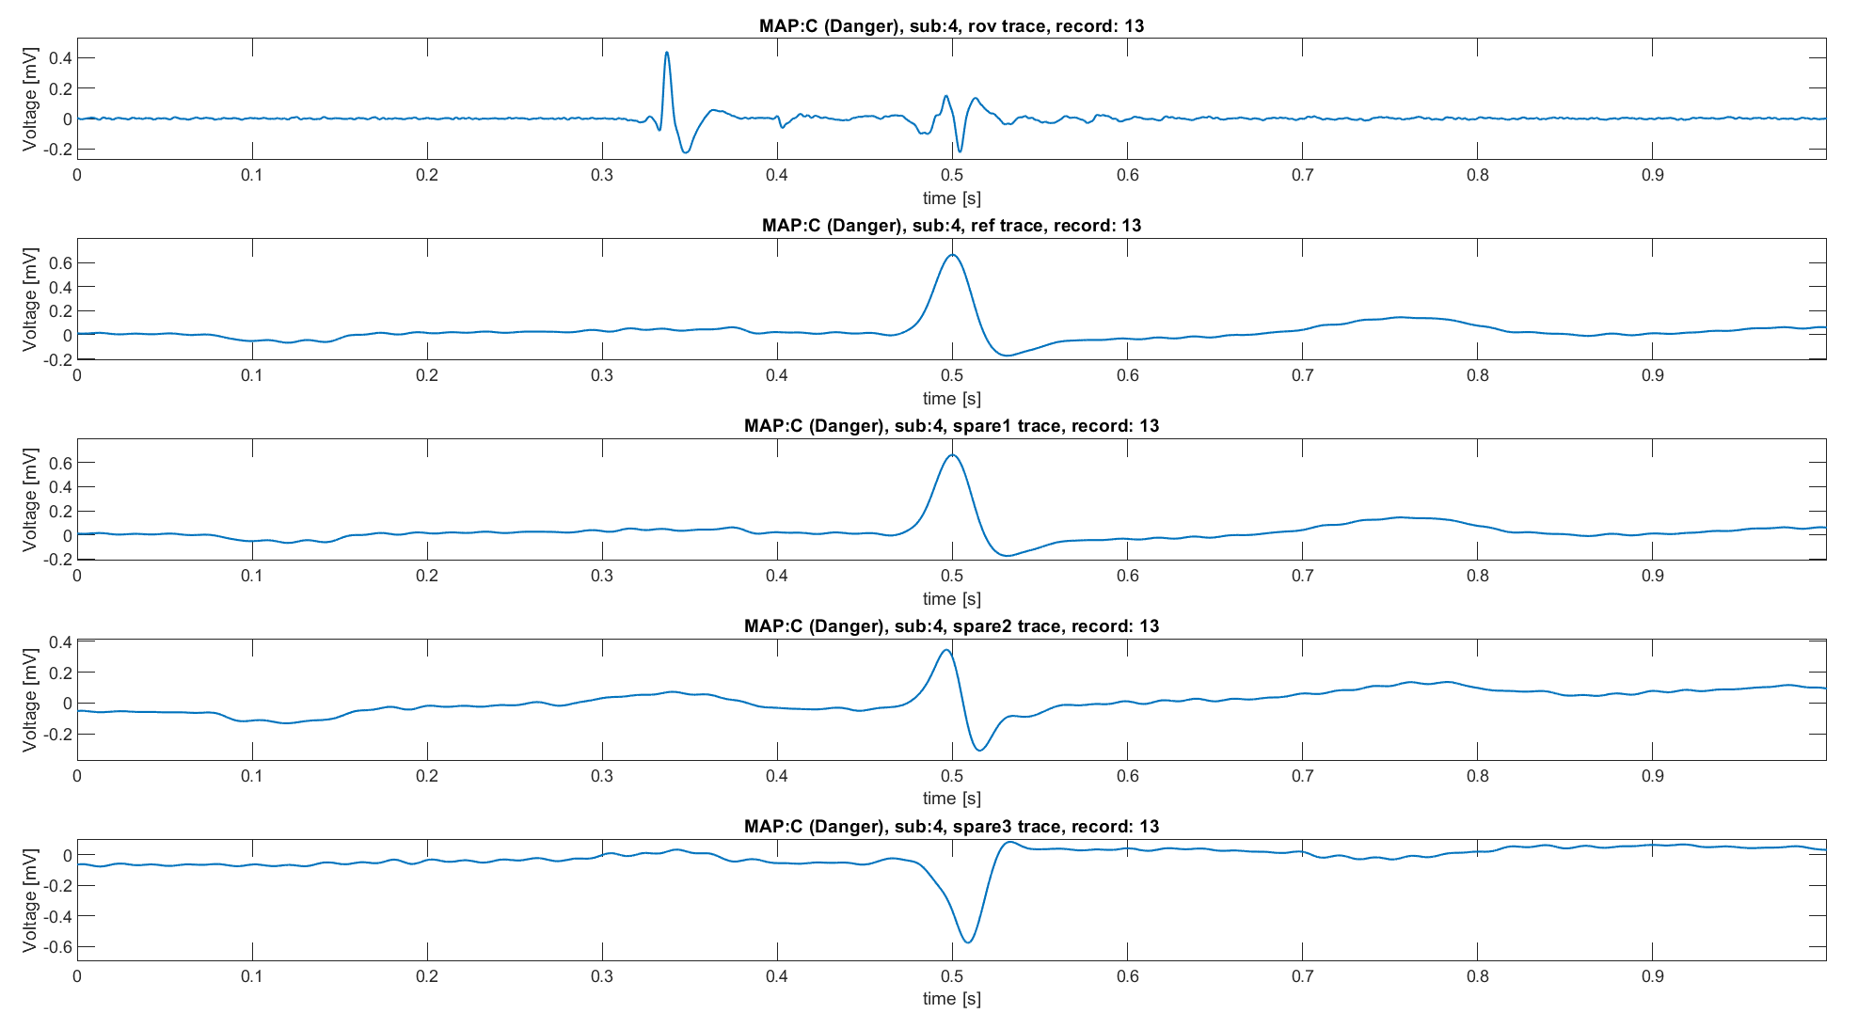
Knowledge on roving signals: recap
Map C
Clear and biphasic atrial component
3 components: atrial activity, ventricular activity and His Bundle passage
Not fixed proportions between atrial and ventricular components
ECG 1
ECG 1
Used for building the classifier
ECG 2
ECG 3

Slide 10
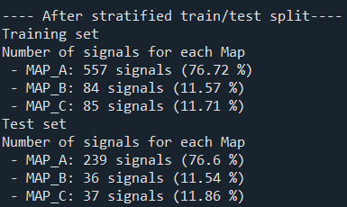
Stratified train/test split
Of the 1038 signals into the dataset:
796 are MAP A (76.69%)
120 are MAP B (11.56%)
122 are MAP C (11.75%)
Thus, the following conclusions could be done:
Unbalanced dataset towards MAP A
Stratified train/test splitting is necessary
Done with a 70-30% split
Total 726
Total 312

Slide 11
Outline
Why building a heuristic classifier
Knowledge on roving signals: recap
Heuristic classifier: pseudo code
Performance
Conclusions

Slide 12
Heuristic classifier: pseudo code
For each roving trace (post-alignment):
Divide the trace in three segments:
Atrial: t<0.38s
Ventricular: after t>0.42
His bundle: 0.38<t<0.42
Compute the absolute value of the segment, then into each (modulus) segment find the maximum:
For atrial and ventricular phase take the maximum as it is
For His phase, consider the maximum significant if higher than a threshold, otherwise assign NaN to its value
Then apply the following set of rules:
Applied on both filtered and not filtered signals
Does the signal have an His peak?
No
Is the ventricular peak lower than atrial one?
No
NB: in this way MAP B, effective, is harder to be chosen, leading to a more “conservative” algorithm, as is should be the surgeon.
MAP A, indifferent, is chosen if the atrial peak is higher than the ventricular one.
Finally, MAP C, dangerous, is chosen as first one if there’s an over-threshold peak into the His bundle.
MAP B
Yes
Yes
MAP C
MAP A

Slide 13
Heuristic classifier: pseudo code
For each roving trace (post-alignment):
Divide the trace in three segments:
Atrial: t<0.38s
Ventricular: after t>0.42
His bundle: 0.38<t<0.42
Compute the absolute value of the segment, then into each (modulus) segment find the maximum:
For atrial and ventricular phase take the maximum as it is
For His phase, consider the maximum significant if higher than a threshold, otherwise assign NaN to its value
Then apply the following set of rules:
Does the signal have an His peak?
No
Is the atrial peak > 0.5 mV?
No
Is 0.1< atrial peak<0.3 ?
No
Is atrial peak > ventricular peak?
No
NB: in this way MAP B, effective, is harder to be chosen, leading to a more “conservative” algorithm, as is should be the surgeon.
MAP A, indifferent, is chosen if atrial peak is higher than the threshold or if the higher than the ventricular one.
Finally, MAP C, dangerous, is chosen as first one if there’s an over-threshold peak into the His bundle.
MAP B
Yes
Yes
Yes
Yes
MAP C
MAP A
MAP B
MAP A

Slide 14
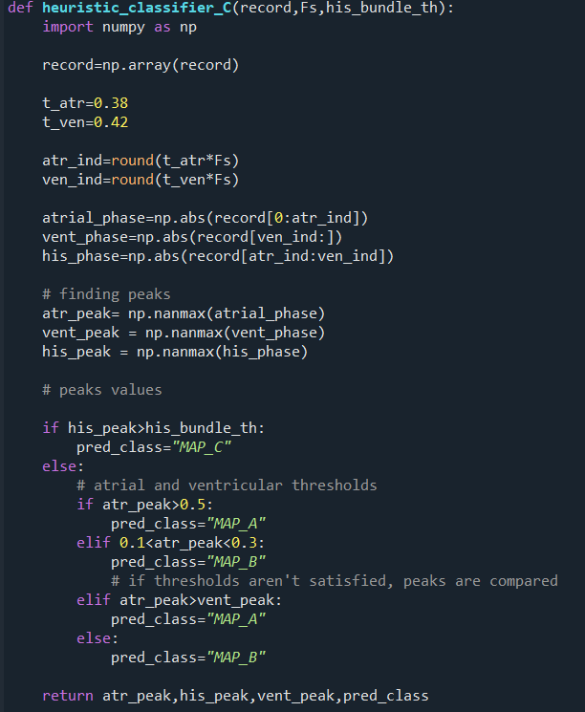
Code functioning
The given record is divided into three segments and the modulus is taken
Atrial phase: abs(record[t=0 : t=0.38])
Ventricular phase: abs(record[t=0.42 : t=t_end])
His phase: abs(record[t=0.38 : t=0.42])
Into each segment the maximum is evaluated
His_bundle peak is compared with the threshold
If his_peak<his_bundle_th → his_peak = NaN
Then a first block of rules use priors on thresholds :
If his_peak>th_his→ MAP_C
Else:
Elif atrial_peak>0.5→ MAP_A
Elif 0.1<atrial_peak<0.3→ MAP_B
And one utilizes the information regarding the dominance between the atrial and ventricular peaks
Elif atrial_peak>vent_peak→ MAP_A
Else → MAP_B

Slide 15
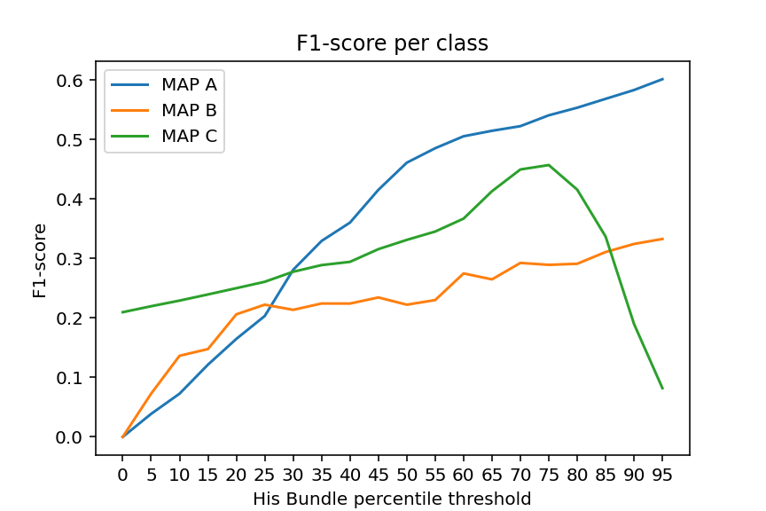
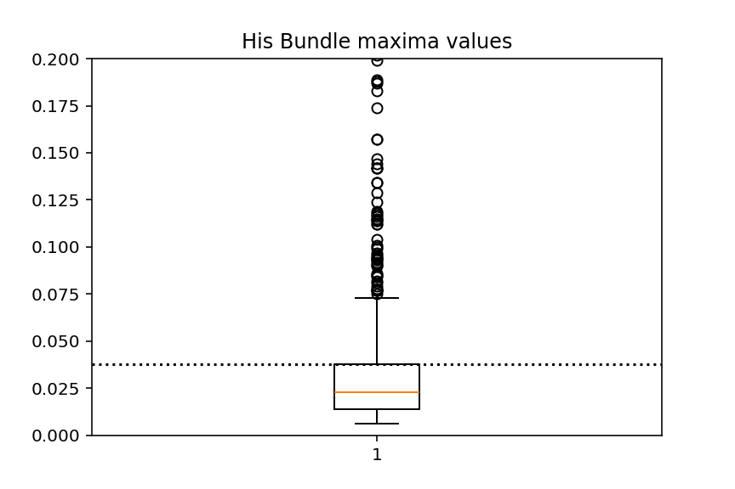
His threshold tuning
His peak threshold is fixed as a percentile of the distribution of maxima points around the His Peak of the training signals.
To do it:
From each record the modulus of the His segment is taken
His phase: abs(record[t=0.38 : t=0.42])
Boundaries are fixed as wide as possible without f1-score reduction.
Then the maximum of the segment is evaluated and saved into a vector of maximum_points
For each class, the F1-score value is evaluated as a function of the threshold, leading to the plot on the right.
Higher class F1-score combination is reached with a threshold equal to the 75th percentile
Finally, the value of the threshold is saved for being used in the classification phase
In conclusion, the threshold was 0.0377 mV
Threshold position into the distribution
If train/test split is done, the threshold is evaluated one time for all. On the other hand, in case of LOPO CV, threshold is evaluated iteratively on the train set of the current iteration. See appendix 1.

Slide 16
Outline
Why building a heuristic classifier
Knowledge on roving signals: recap
Heuristic classifier: pseudo code
Performance
Conclusions

Slide 17
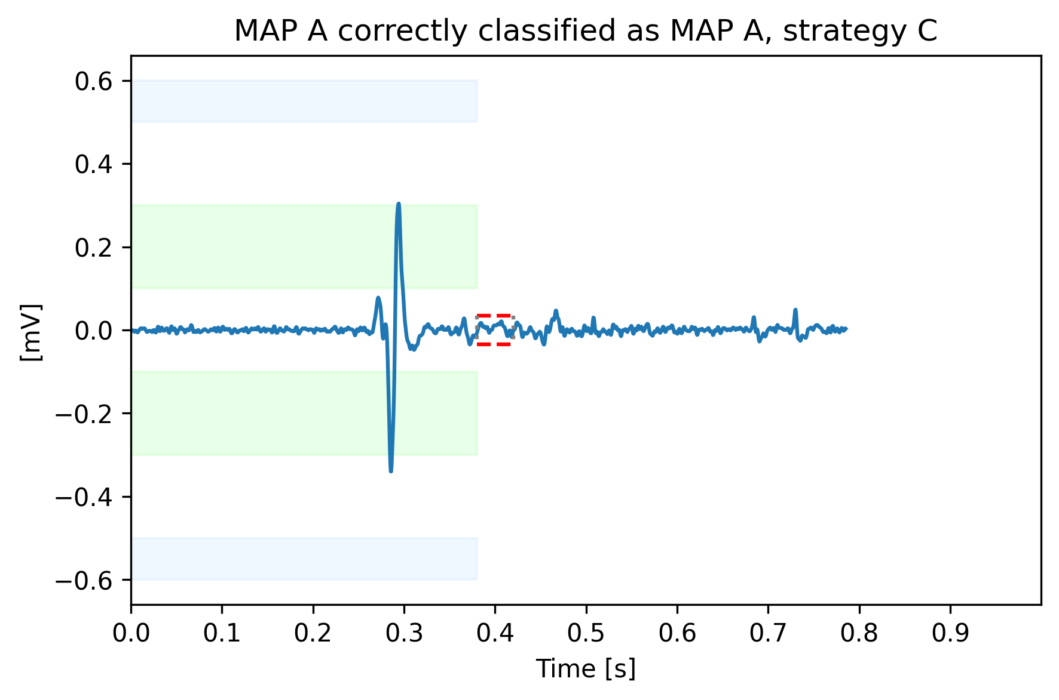
Correctly classified example 1
MAP A correctly classified
The algorithm recognize as majoritarian the atrial peak (in modulus)
Blue boxes: MAP A atrial peak threshold, green boxes MAP B atrial threshold, red dashed lines his peak thresholds

Slide 18
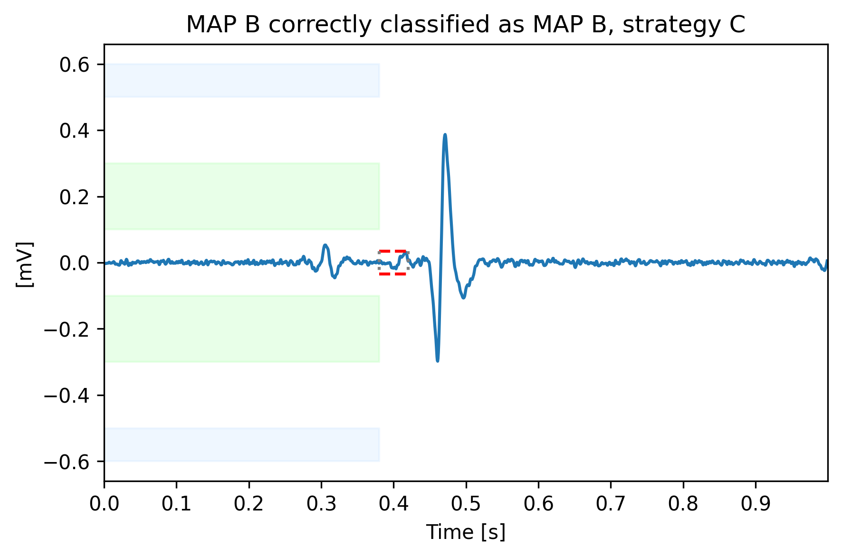
Correctly classified example 2
MAP B correctly classified
Higher ventricular peak is used to correctly assign this signal to map B.
Blue boxes: MAP A atrial peak threshold, green boxes MAP B atrial threshold, red dashed lines his peak thresholds

Slide 19
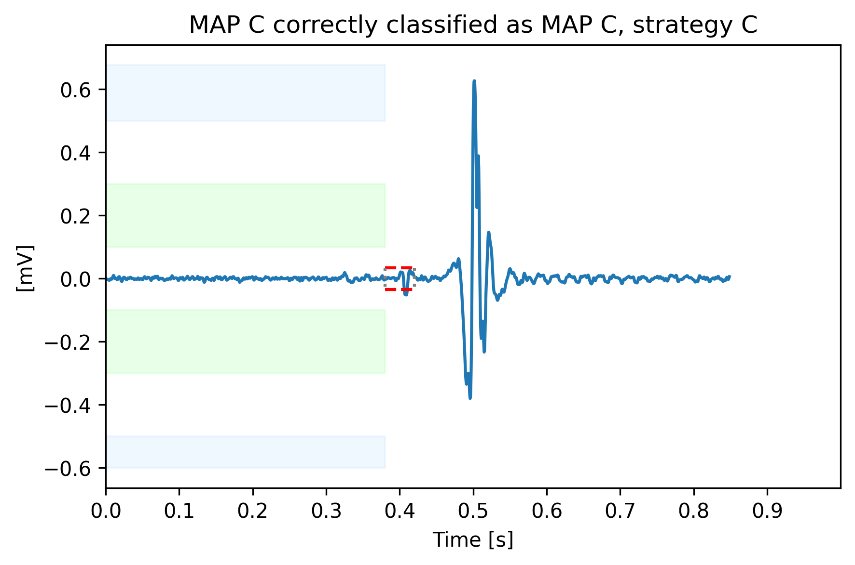
Correctly classified example 3
MAP C correctly classified
His bundle is correctly recognized and used to classify this signal into MAP C.
Blue boxes: MAP A atrial peak threshold, green boxes MAP B atrial threshold, red dashed lines his peak thresholds

Slide 20
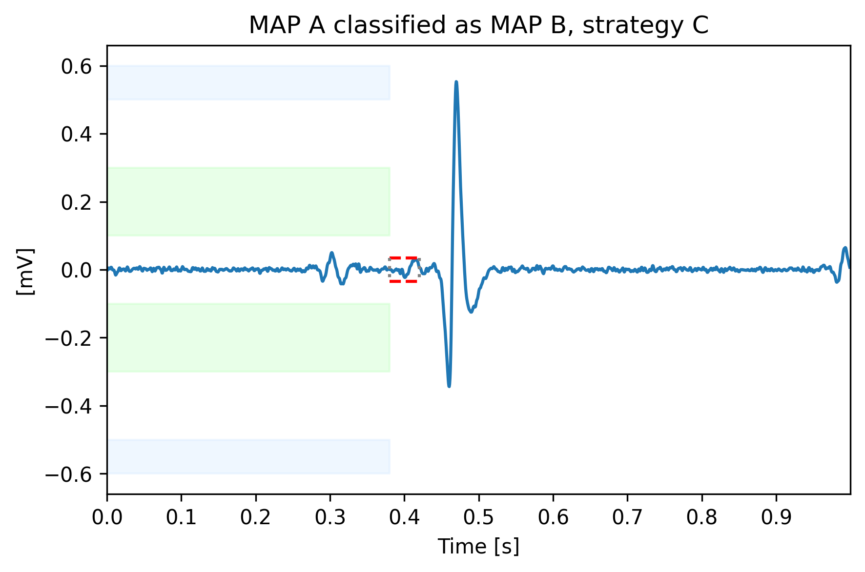
Misclassified example 1
MAP A classified as MAP B
The algorithm captures the uncertainty given by the clear Map B characteristics of the signal
Blue boxes: MAP A atrial peak threshold, green boxes MAP B atrial threshold, red dashed lines his peak thresholds

Slide 21
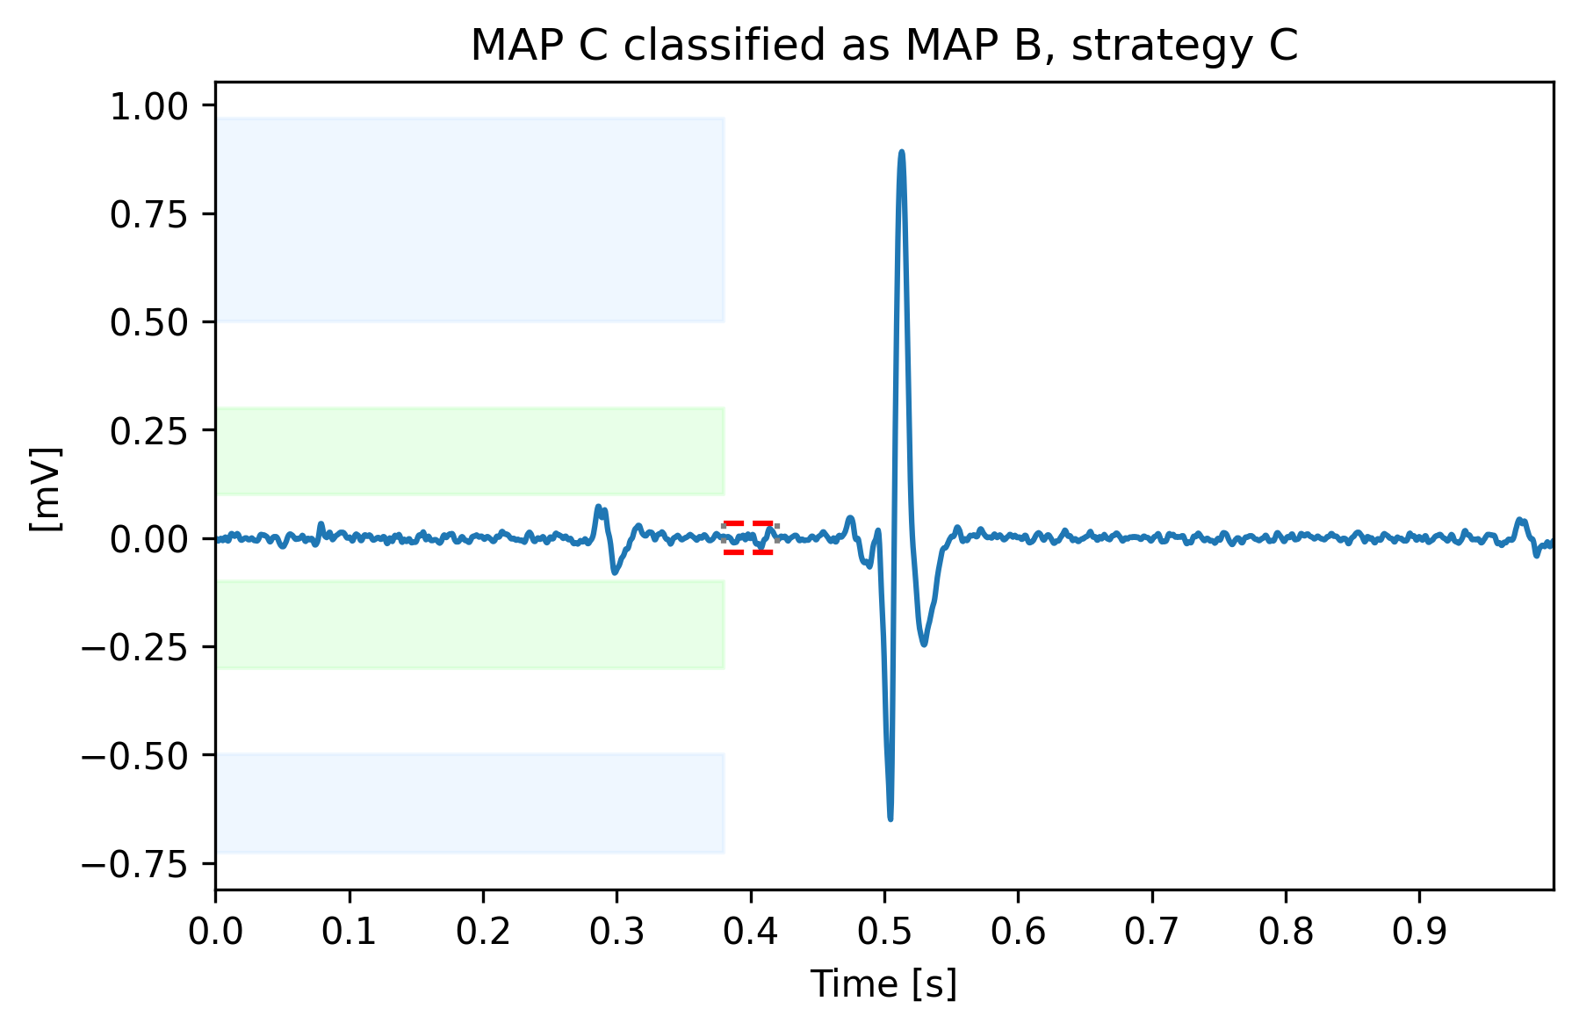
Misclassified example 2
MAP C classified as MAP B
Into this signal an His bundle oscillation is not clearly visible. Then, the signal is assigned to MAP B because of the higher ventricular peak
Blue boxes: MAP A atrial peak threshold, green boxes MAP B atrial threshold, red dashed lines his peak thresholds

Slide 22
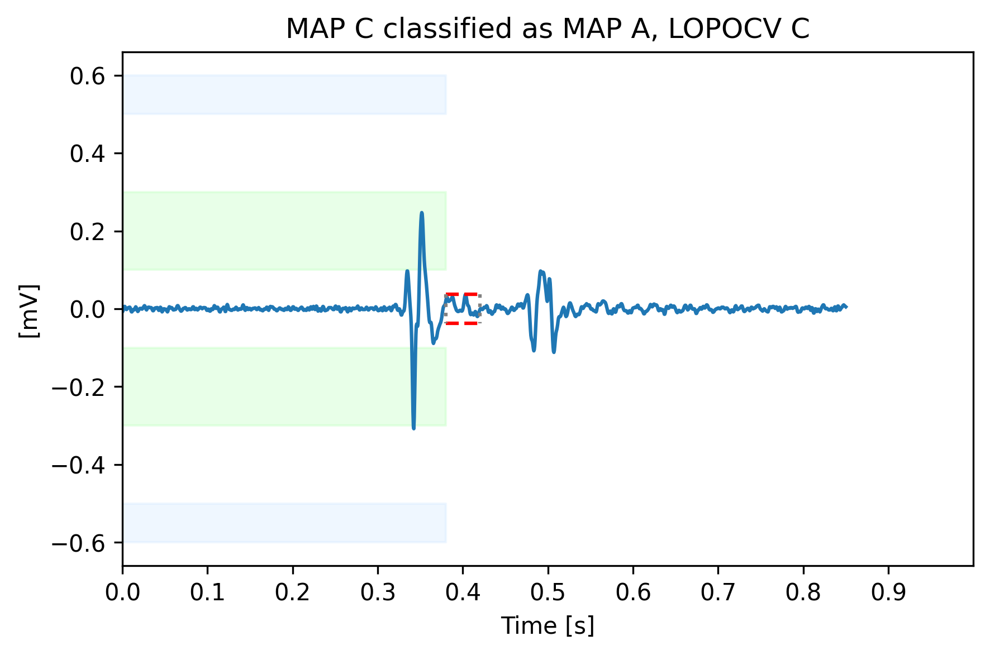
Misclassified example 3
MAP C classified as MAP A
His peak didn’t reach the threshold. Then, as it wasn’t considered significant, the signal is assigned to MAP A because of the higher atrial peak
Blue boxes: MAP A atrial peak threshold, green boxes MAP B atrial threshold, red dashed lines his peak thresholds

Slide 23
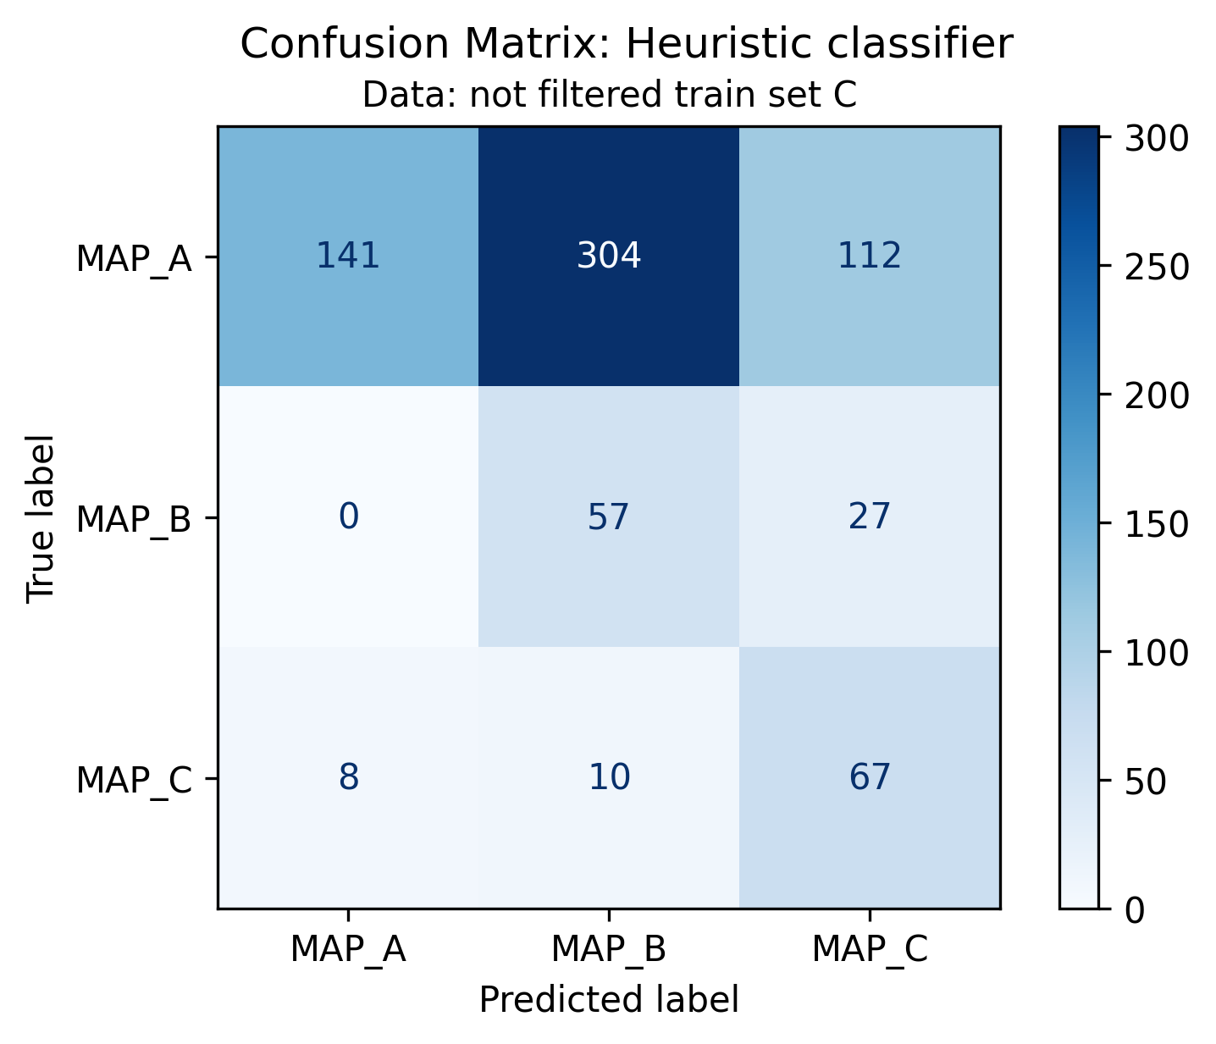
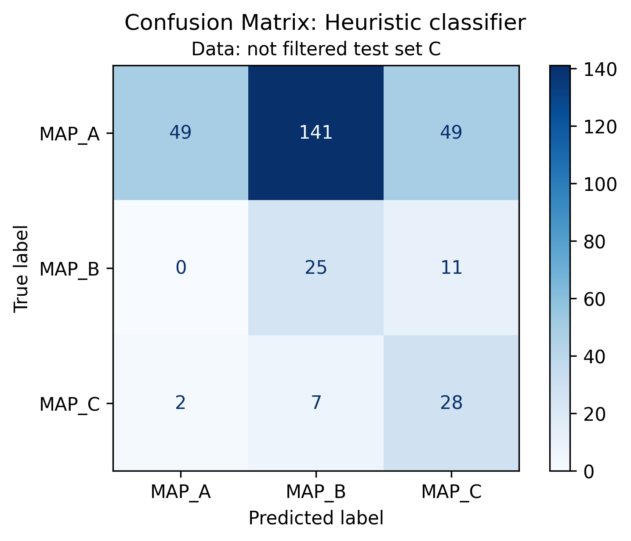
Heuristic classifier: results on original signals
Performance have been evaluated using confusion matrix and standard metrics
The high number of misclassified MAP A signals into MAP B can be explained by looking directly at signals. See Appendix 2 for more details

Slide 24
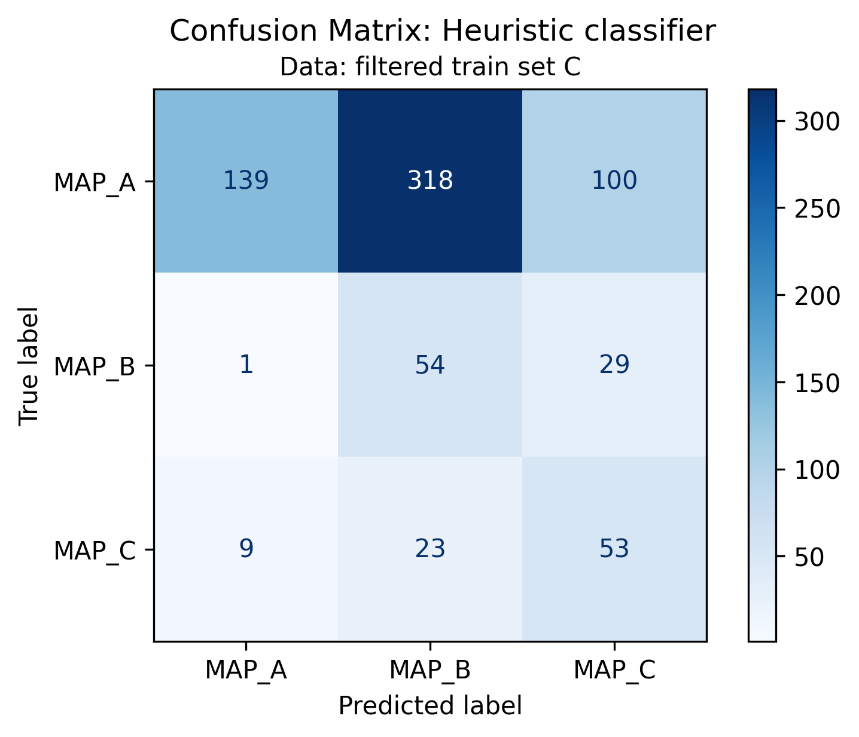
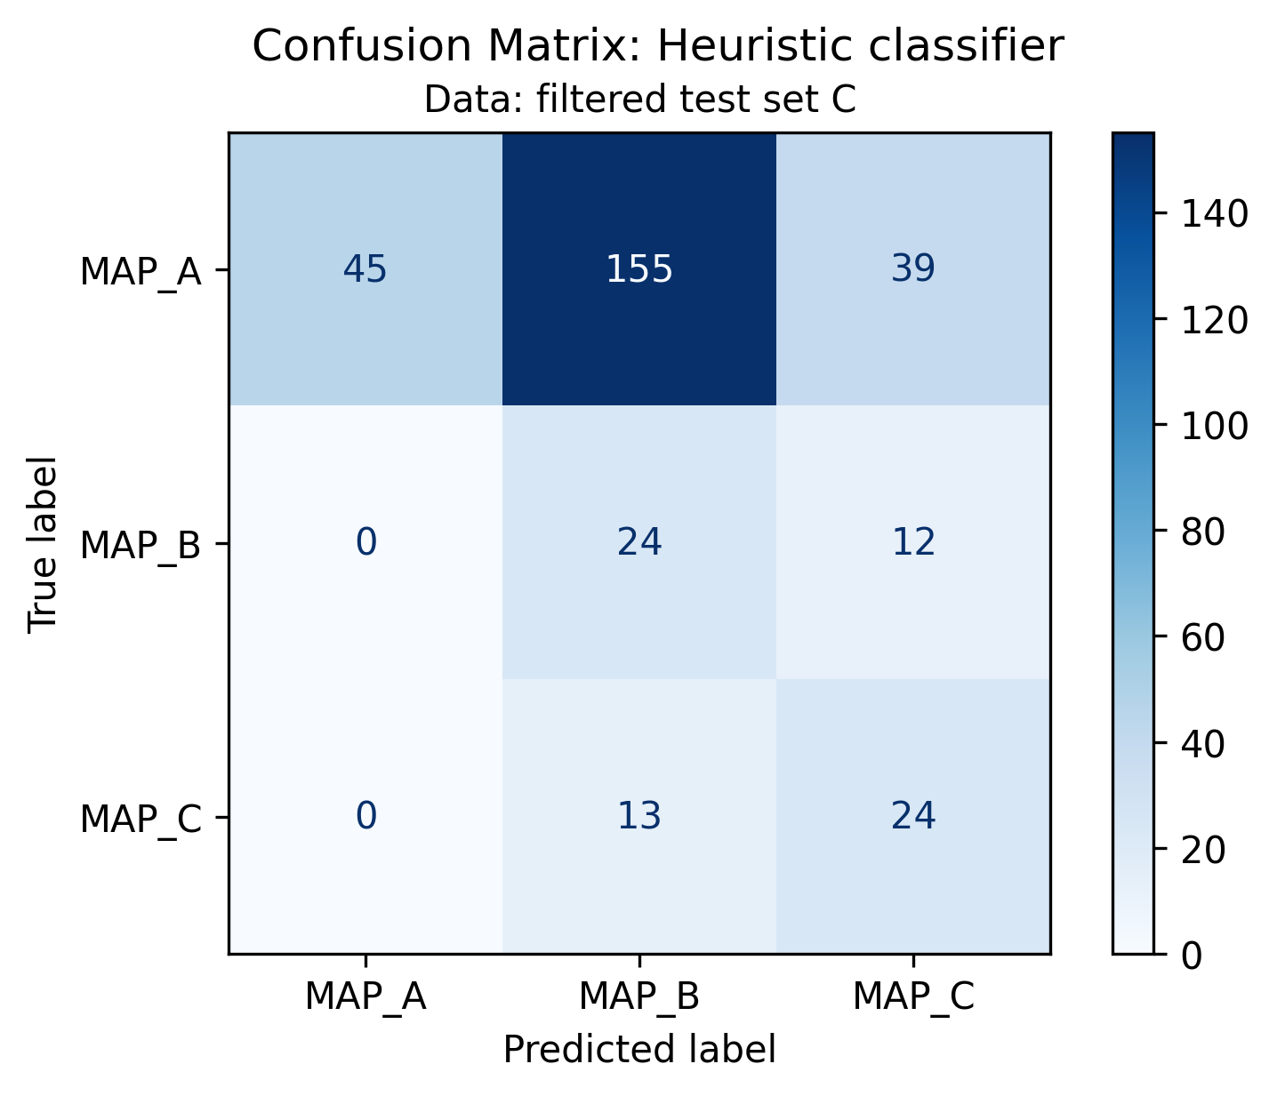
Heuristic classifier: results on filtered signals
Performance have been evaluated using confusion matrix and standard metrics

Slide 25




Heuristic classifier: results on train set
 | Precision | Recall | F1-score | support
Map A | 0.95 | 0.25 | 0.40 | 557
Map B | 0.15 | 0.68 | 0.25 | 84
Map C | 0.33 | 0.79 | 0.46 | 85
Accuracy |  |  | 0.37 | 726
Macro avg | 0.48 | 0.57 | 0.37 | 726
Weighted avg | 0.78 | 0.37 | 0.39 | 726
$$Precision=\frac{TP}{TP+FP}$$
$$Recall=\frac{TP}{TP+FN}$$
$$f1_{score}=2\frac{Precision ∗Recall}{Precision+Recall}$$
$$Accuracy=\frac{TP+TN}{TP+TN+FP+FN}$$

Slide 26
Heuristic classifier: results on test set
 | Precision | Recall | F1-score | support
Map A | 0.96 | 0.21 | 0.34 | 239
Map B | 0.14 | 0.69 | 0.24 | 36
Map C | 0.32 | 0.76 | 0.45 | 37
Accuracy |  |  | 0.33 | 312
Macro avg | 0.47 | 0.55 | 0.34 | 312
Weighted avg | 0.79 | 0.33 | 0.34 | 312
$$Precision=\frac{TP}{TP+FP}$$
$$Recall=\frac{TP}{TP+FN}$$
$$f1_{score}=2\frac{Precision ∗Recall}{Precision+Recall}$$
$$Accuracy=\frac{TP+TN}{TP+TN+FP+FN}$$

Slide 27
Outline
Why building a heuristic classifier
Knowledge on roving signals: recap
Heuristic classifier: pseudo code
Performance
Conclusions

Slide 28
Conclusions
A heuristic classifier has been built with the purpose to act as baseline from which starting further evaluations.
In general, performance are not satisfying, as it could be imaged.
Looking at the confusion matrices and metrics, in both train and test sets:
MAP A has many FN classified as MAP B, probably due to ambiguous signals present into this class. Only temporal-spatial information is not sufficient to classify these signals properly. This situation is reflected by the good precision juxtaposed, however with low recall.
MAP B il classified well in terms or recall, but suffers of very low precision, because of the presence MAP A misclassified signals.
MAP C has low precision and recall, but at least half signals are correctly classified, leading to the conclusion that the threshold comparison result could be seen as a first hint to recognize these signals, even if clearly not sufficient.
The most important advantage of this algorithm is the full explainability of the process. In fact, the significance of the His Bundle peak can be easily explained, differently from what happened when built-in functions.
In conclusion the presented set of rules is a simple classifier, which can be used as baseline to start the classification with a true machine learning model.

Slide 29
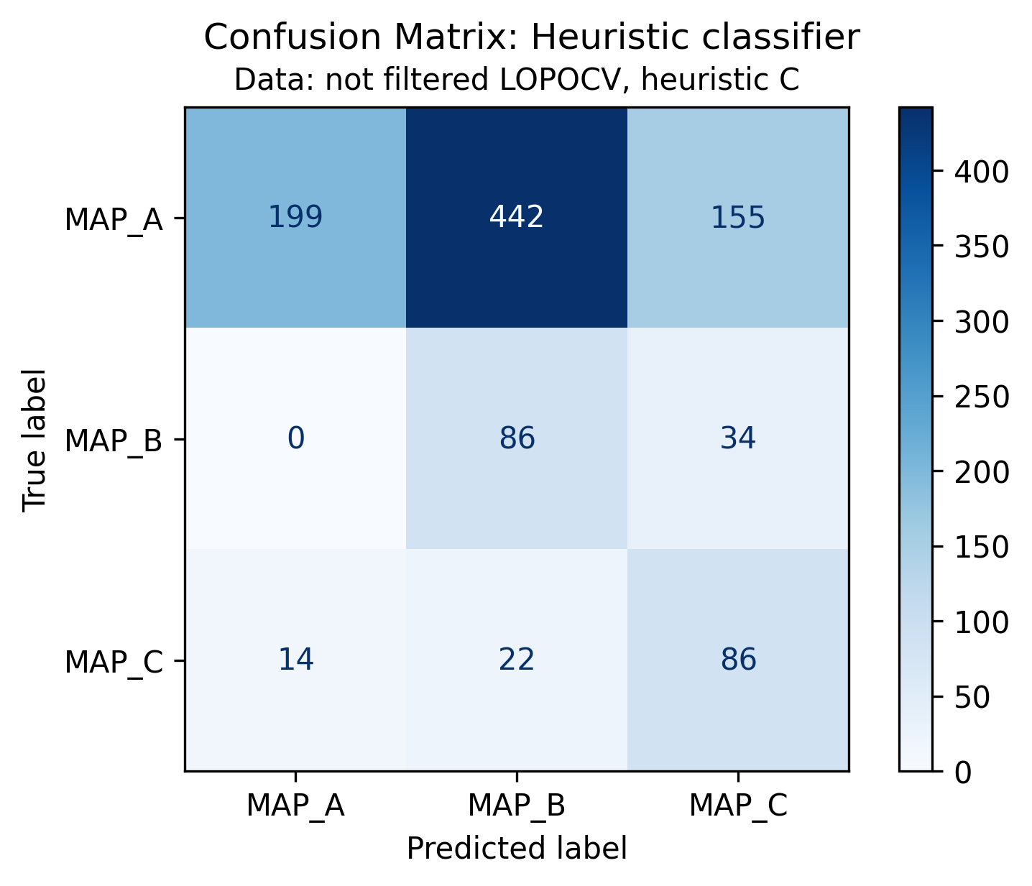
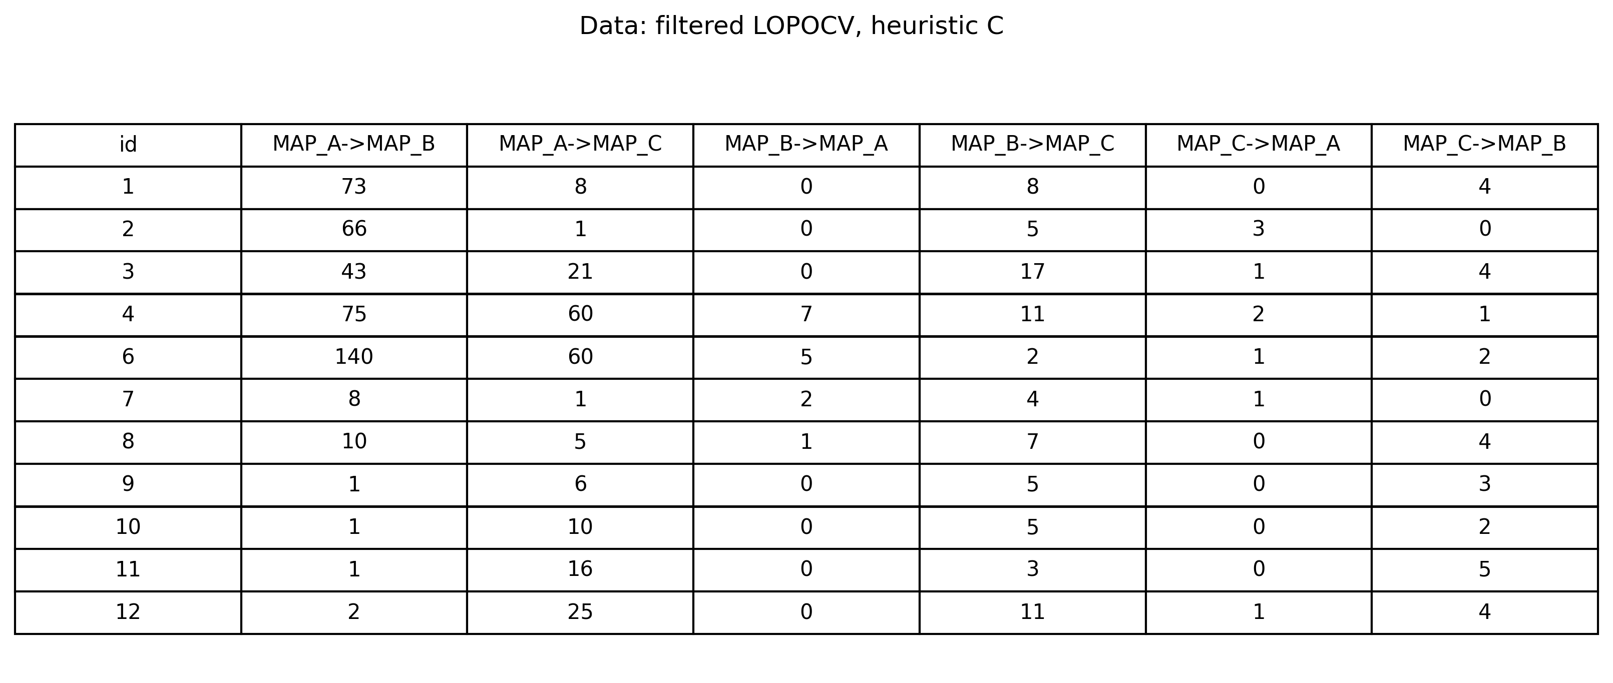
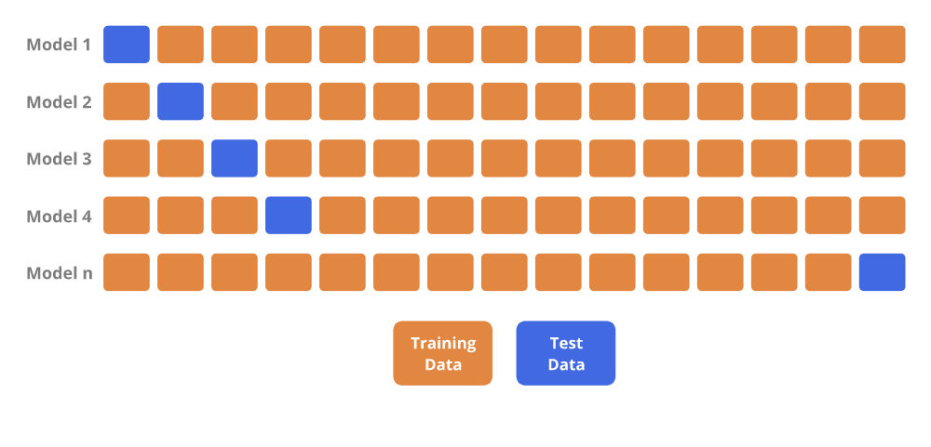
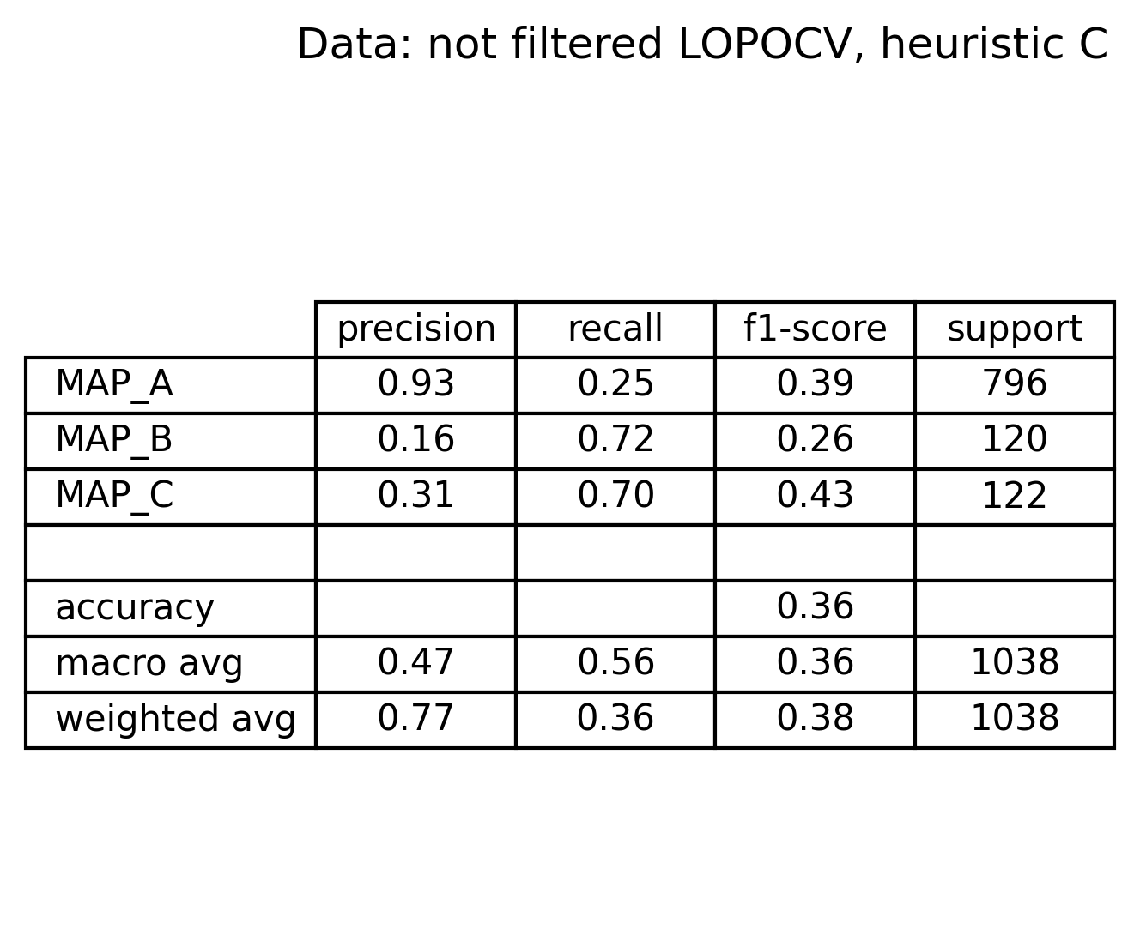
Appendix 1: what if LOPOCV is performed?
Instead of using a train/test split, one could try to match the inter-subject variability by using a Leave One Patient Out Cross Validation technique.
Iteratively, each patient is the test set while the others act as train set
The CM and the metrics summary are reported on the right.
Metrics are comparable with the ones obtained with train/test split
In addition, respect to train/test split, this strategy allow to check the number of misclassified signals for each subject and for each class.
Seems that some subjects carry the greatest number of misclassifications (1,2,3,4,6)
Sub 2 has the highest number of misclassified signals relatively to the number of MAP A signals (66 on 78).

Slide 30
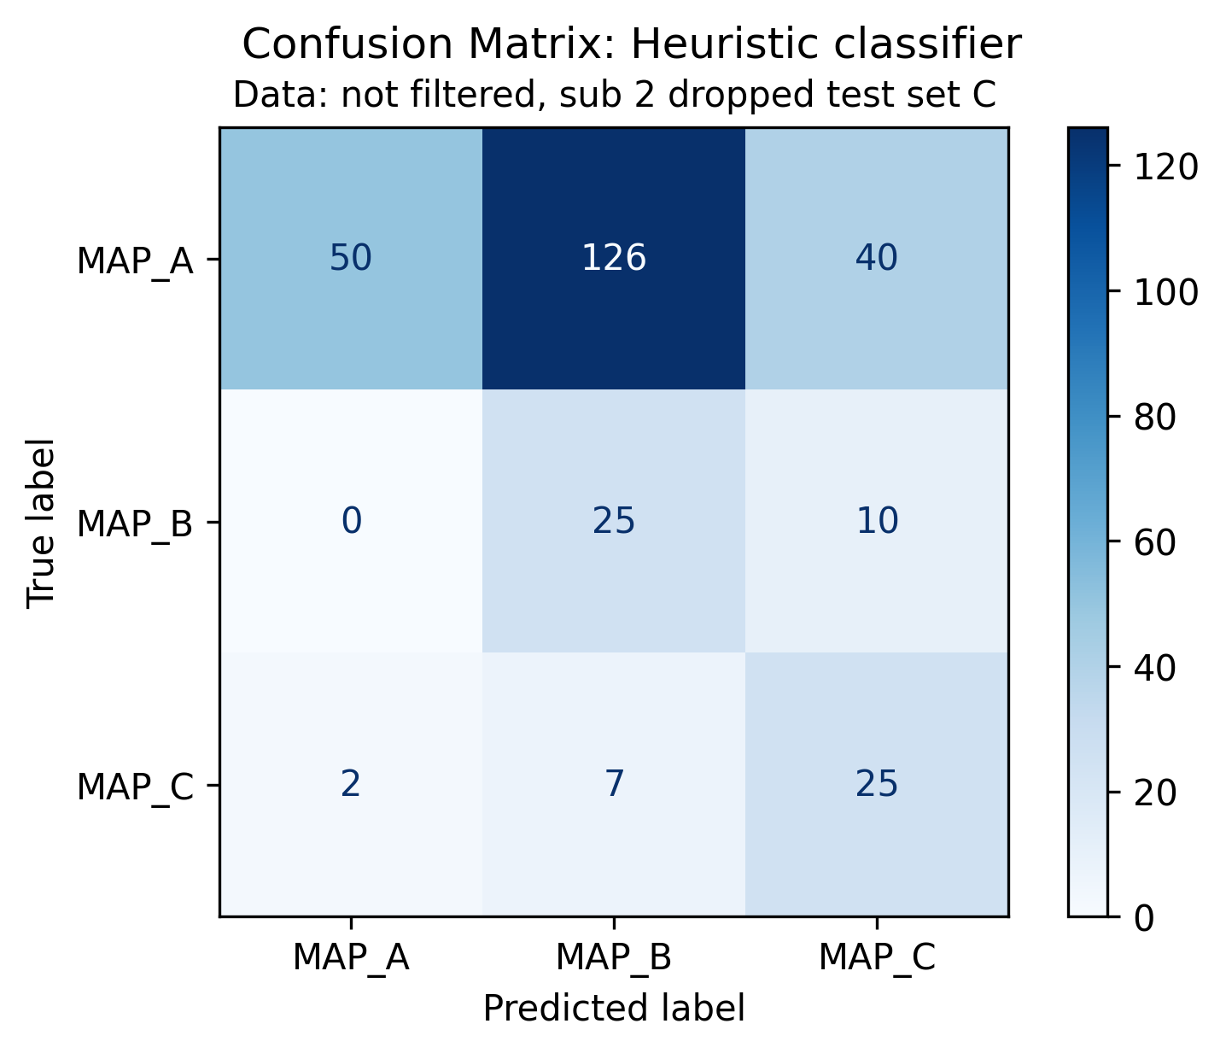
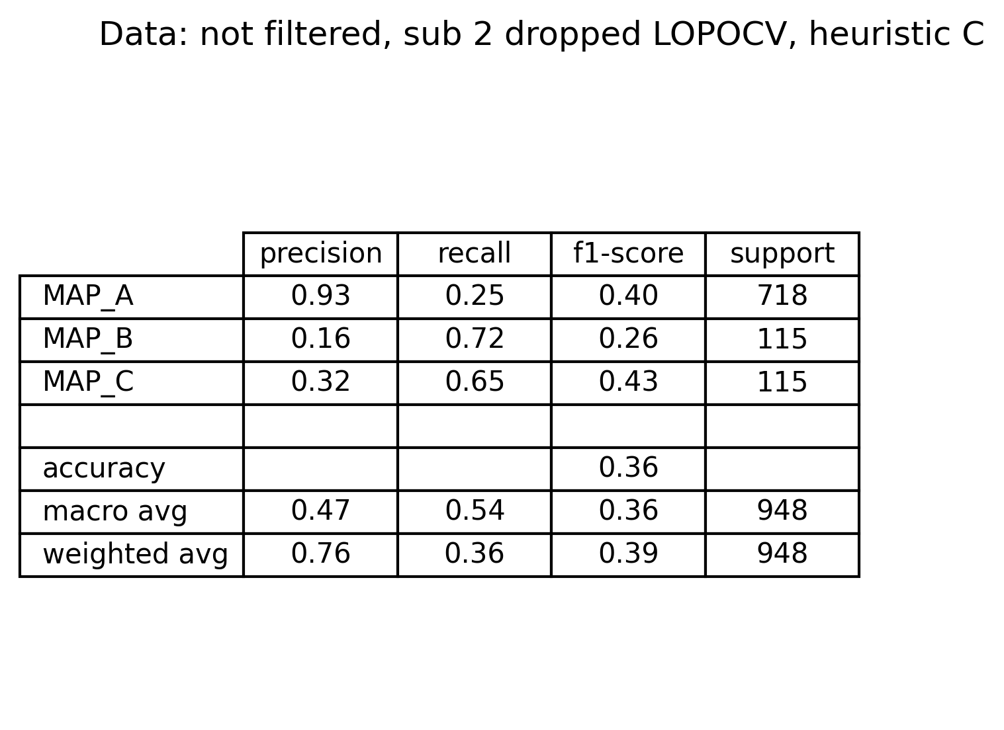
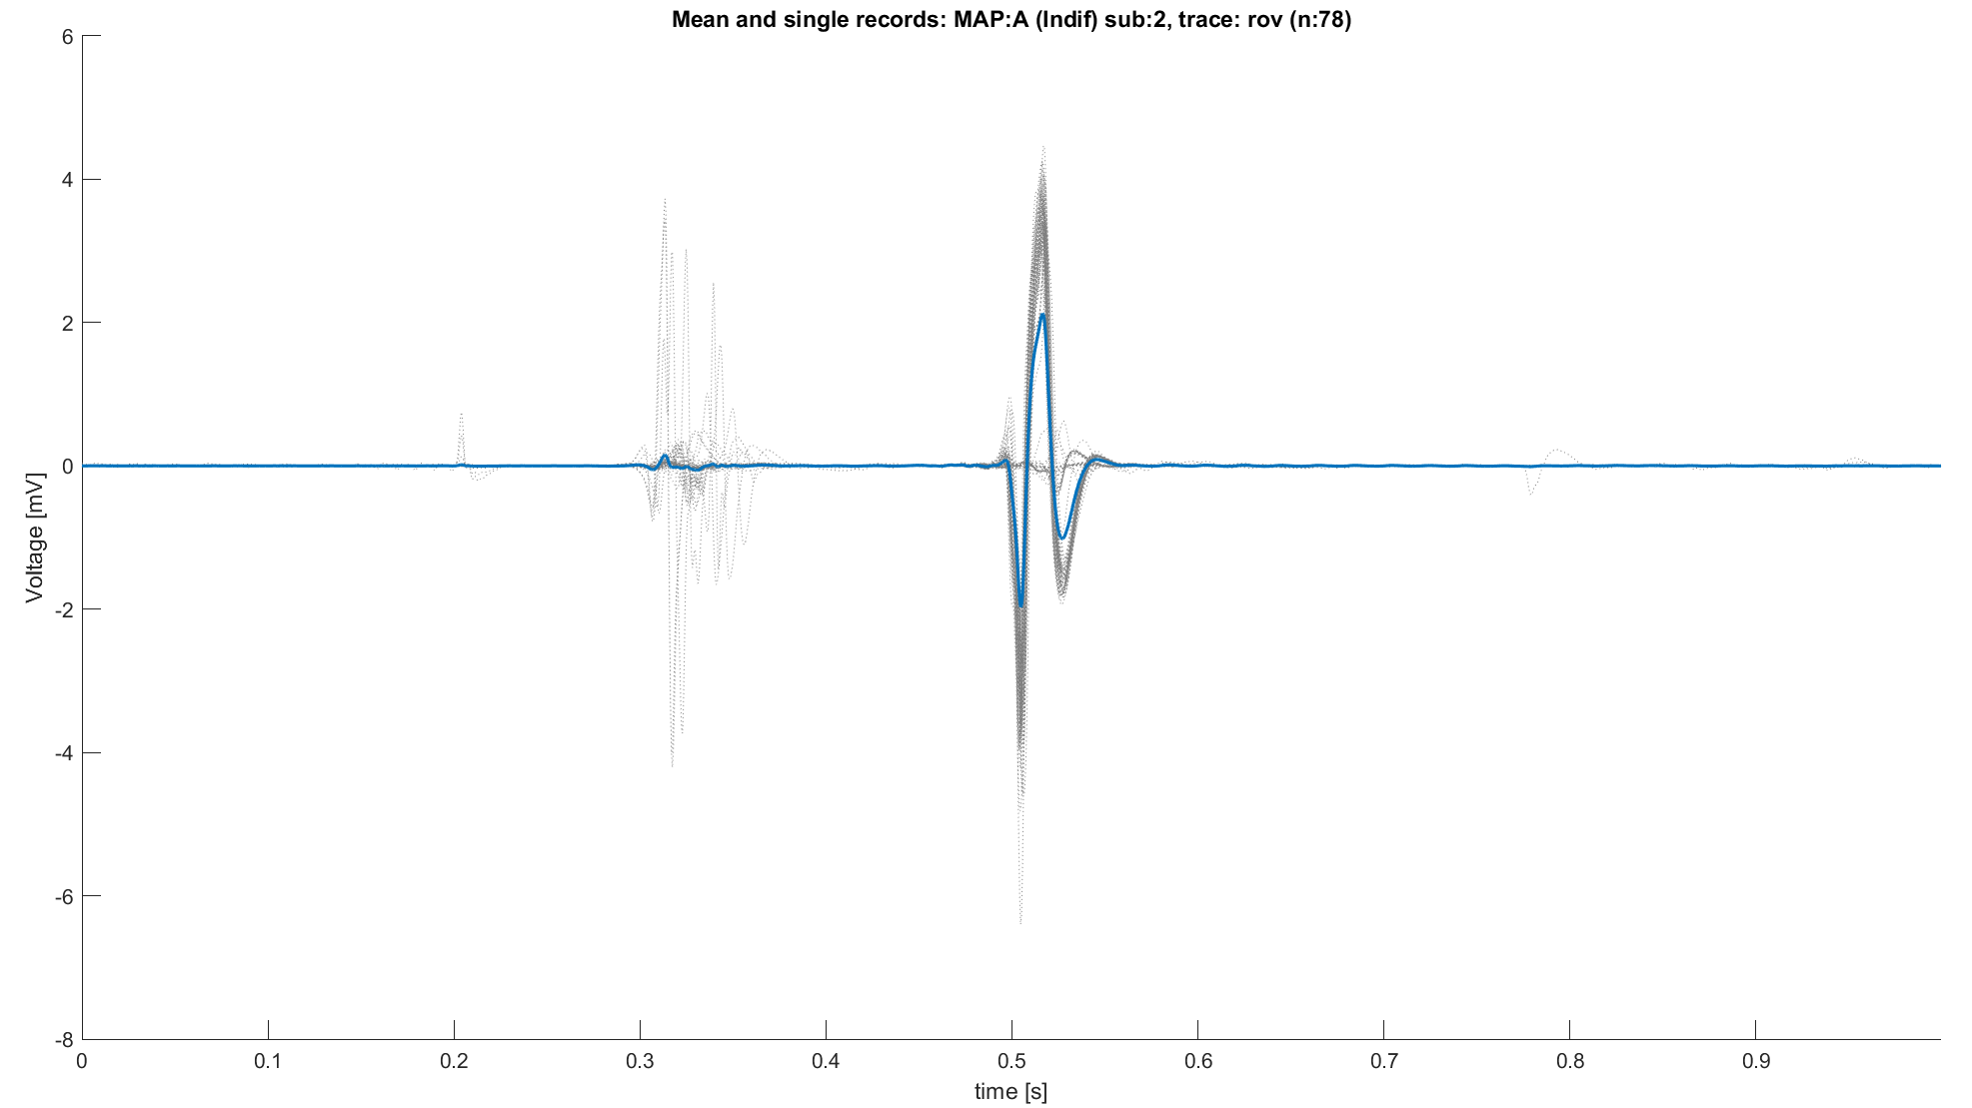
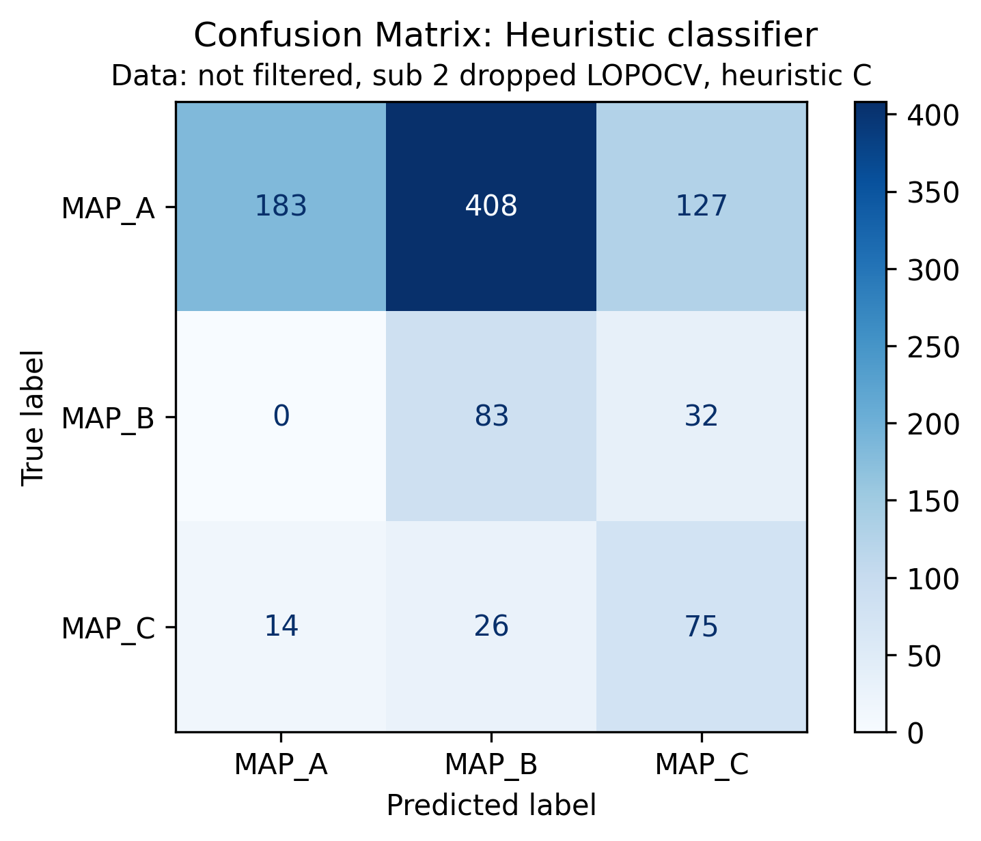
Appendix 2: what if subject 2 is left out?
Subject 2 has a problematic peculiarity: almost all signals classified as MAP A have MAP B characteristics.
What if subject 2 is left out?
In both train/test and LOPOCV strategies:
Metrics slightly improves
MAP B seems to be better detected.
Remains an open question: how should we interpretate these observations?
Ref trace: ECG L1 with R peak on 0.5s

Slide 31
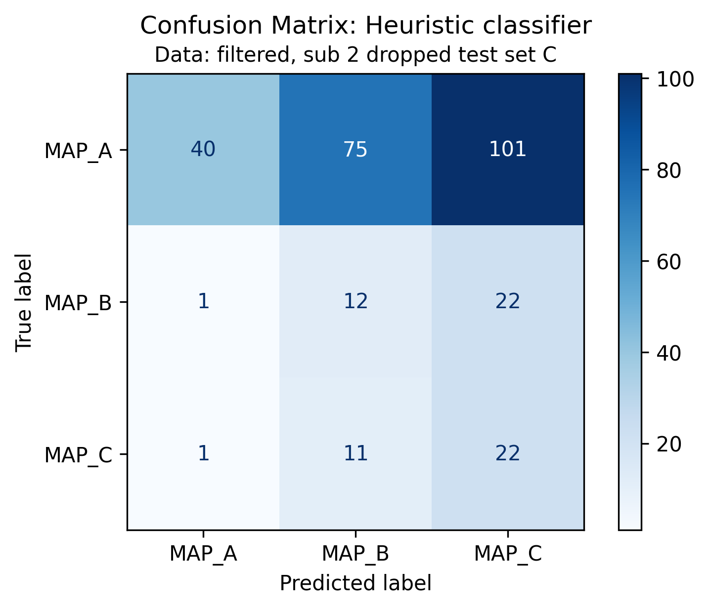
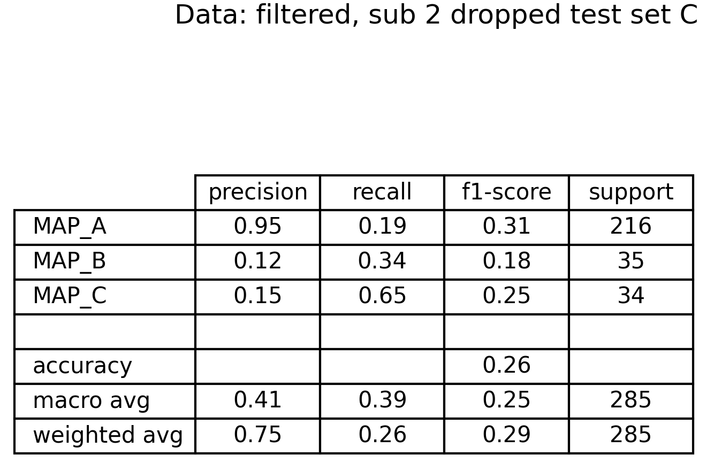
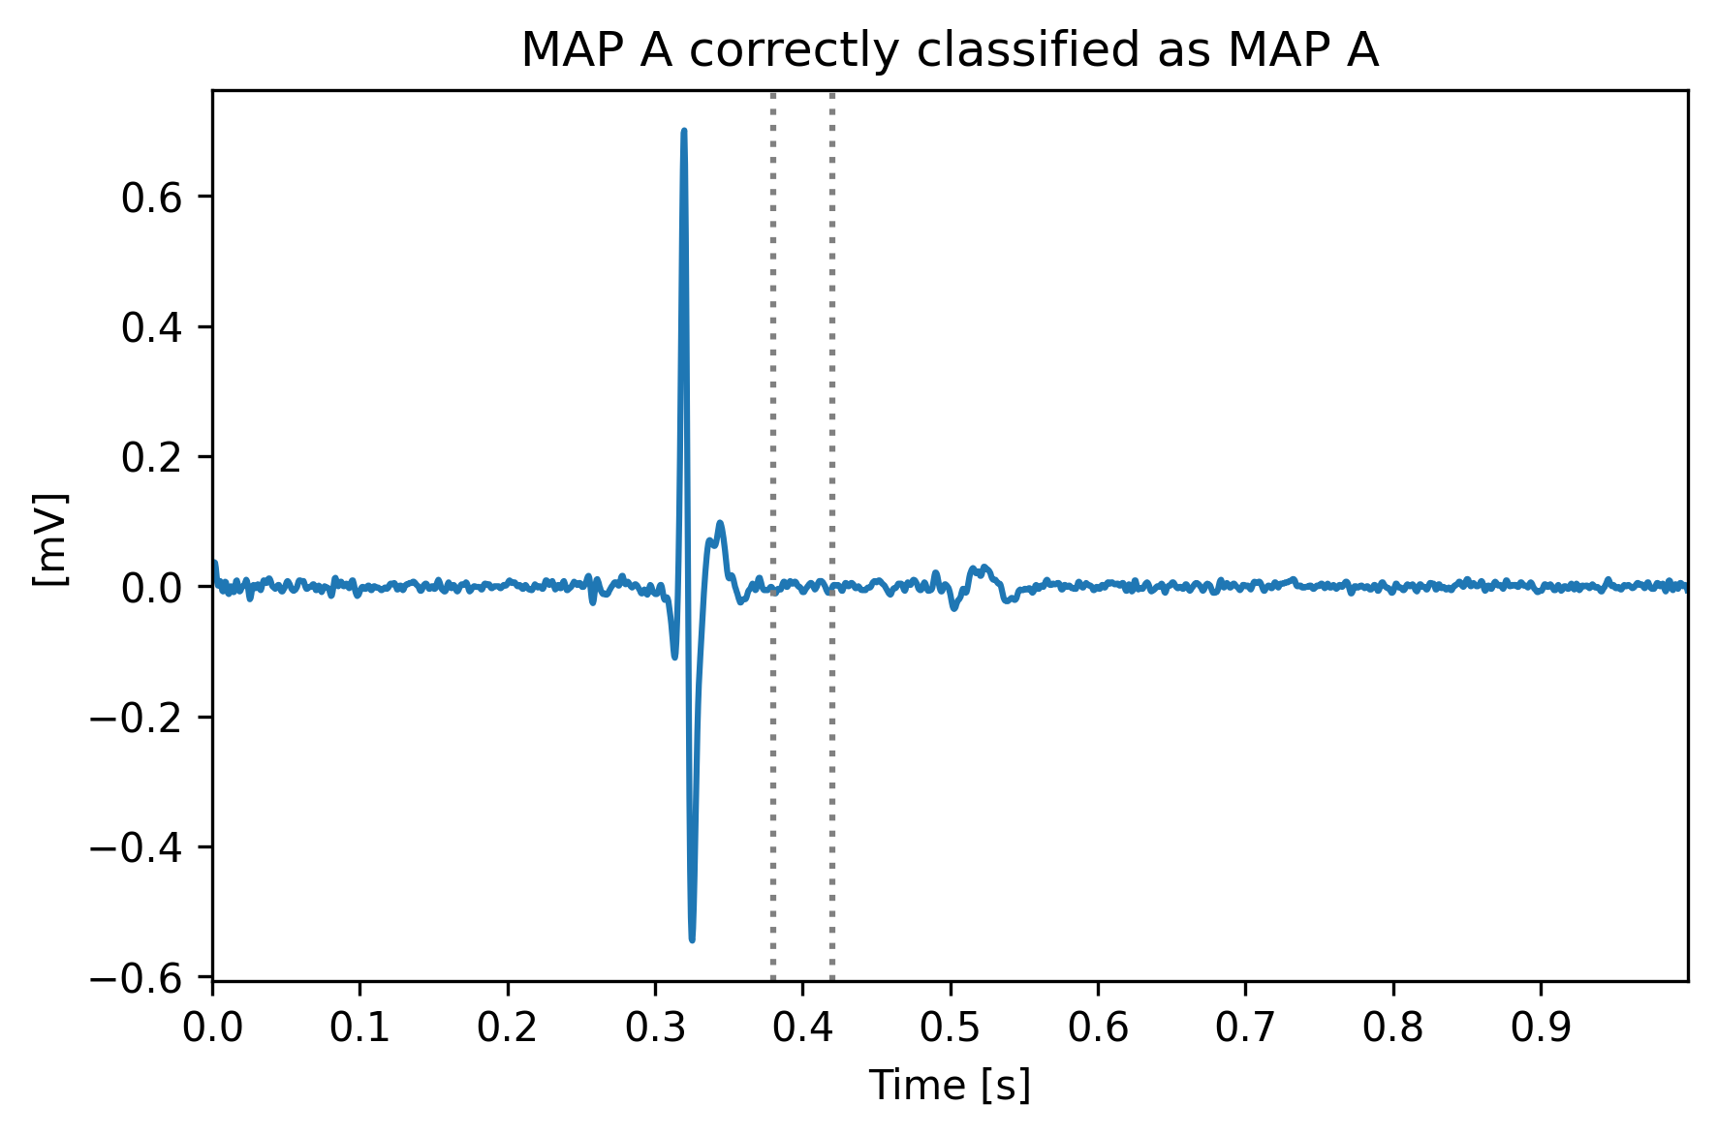
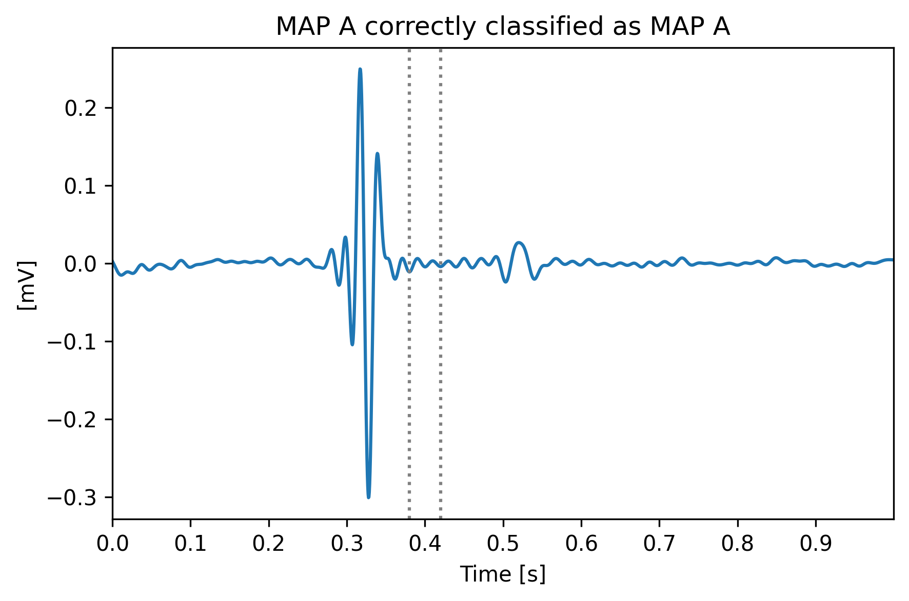
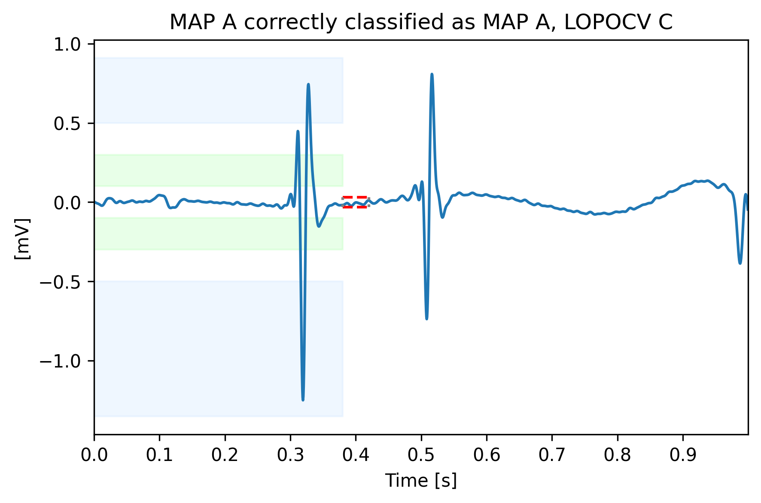
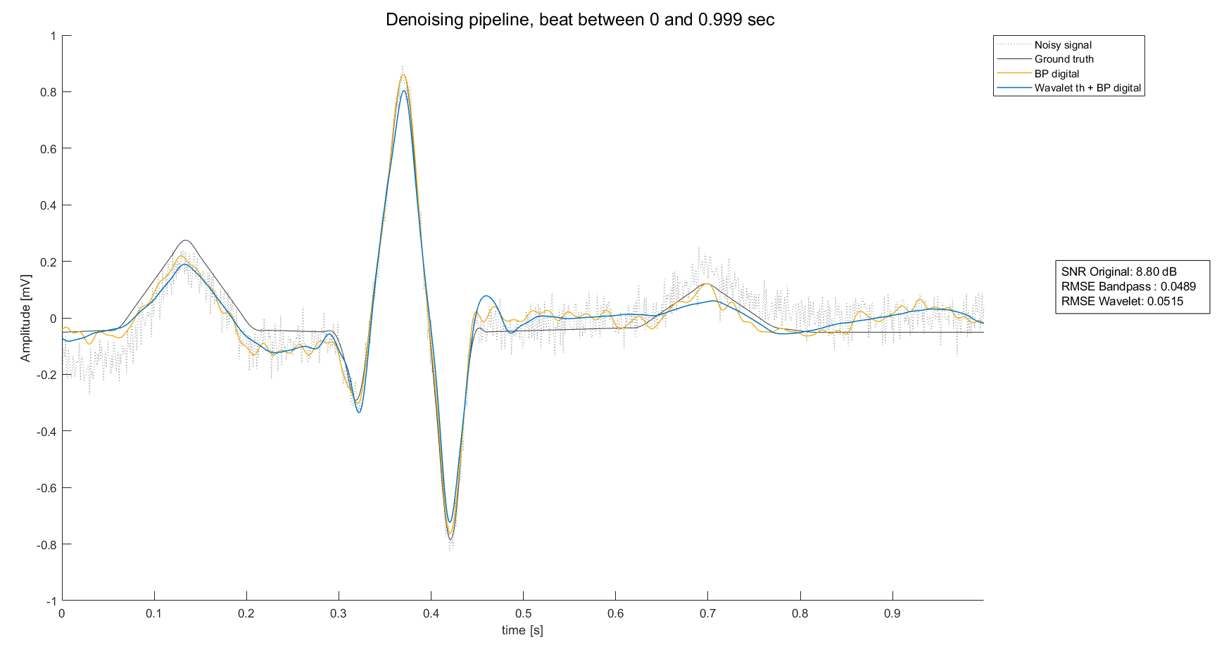
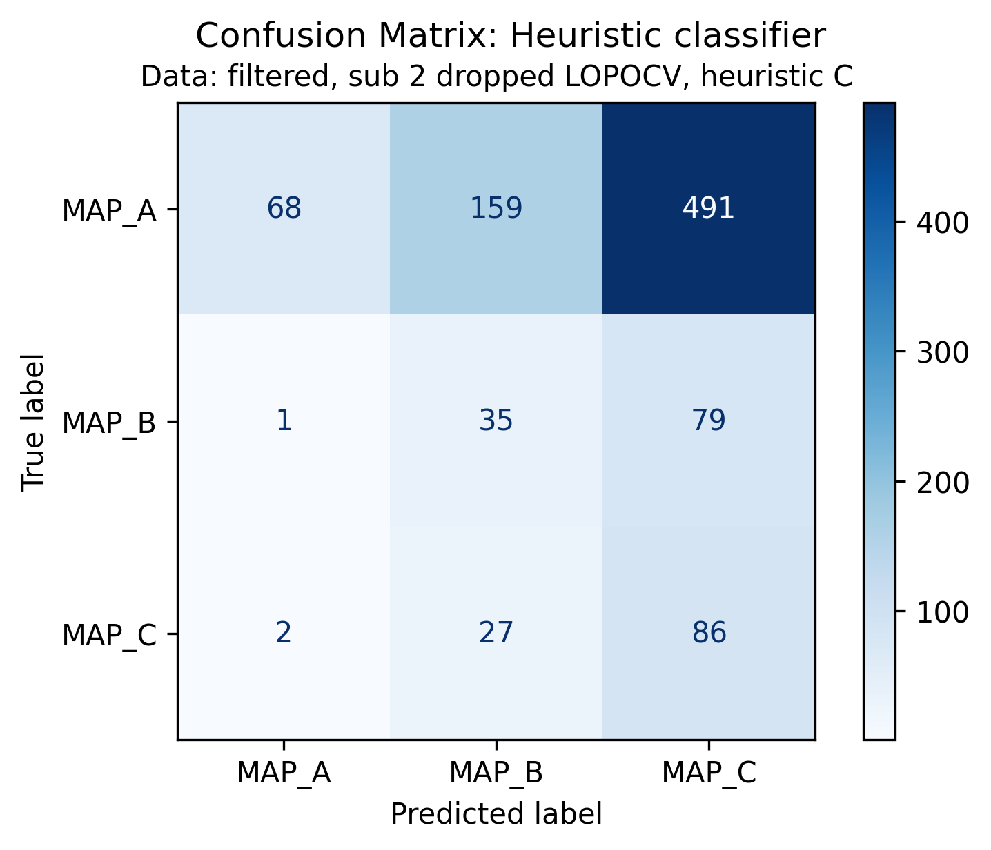
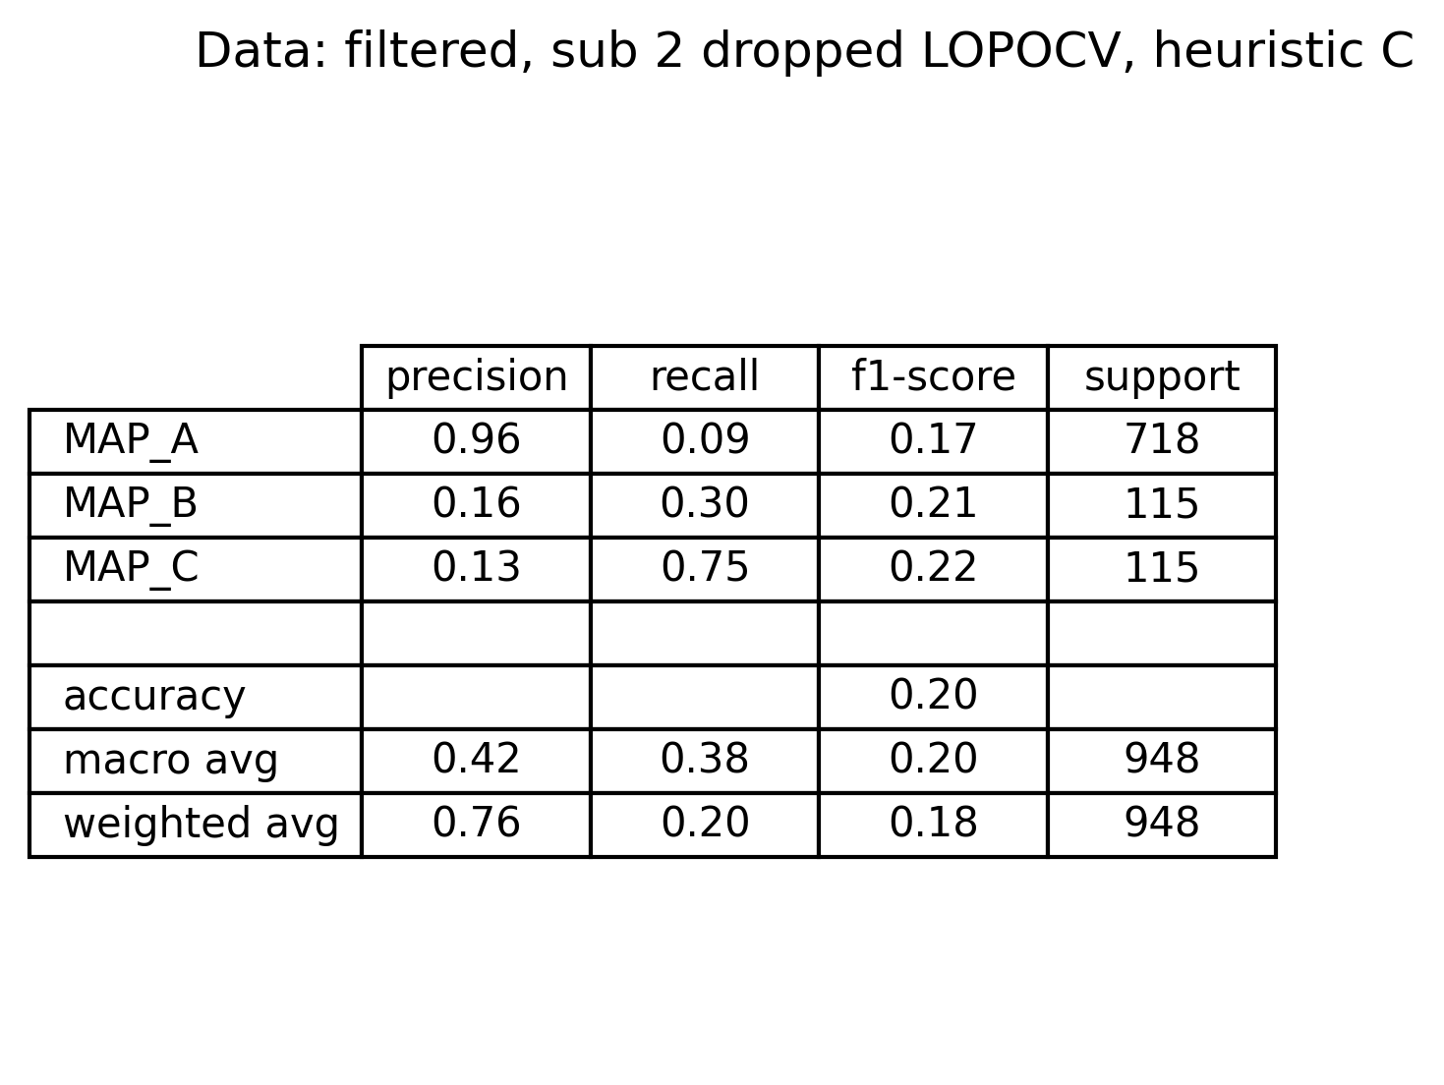
Appendix 3: does have sense filtering?
Even if a filtering pipeline is ready to be used, does have sense using it?
To answer, some observations should be done:
Filter pipeline has been built on ECG signals only, not on EGM.
Due to the low cut-off, high frequency peaks are killed.
Low-pass filter introduce a low frequency distortion unexpectedly.
And because of these aspects, performance drops.
In addition, one should consider that the a priori known information about the signals is valid about the signals as such, without considering additional processing steps. These, would render all the information used in vain.
Original
Filtered
Same signal

